Slide 1
Deep Learning : An Introduction...
Prof. Dharmesh J. Bhalodiya

Slide 2
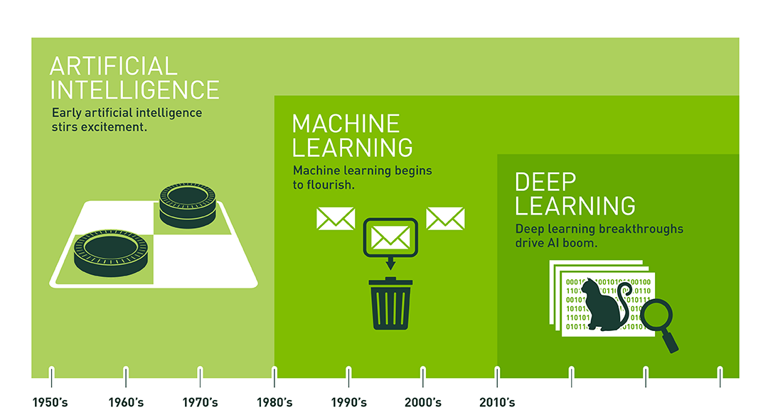

Slide 3
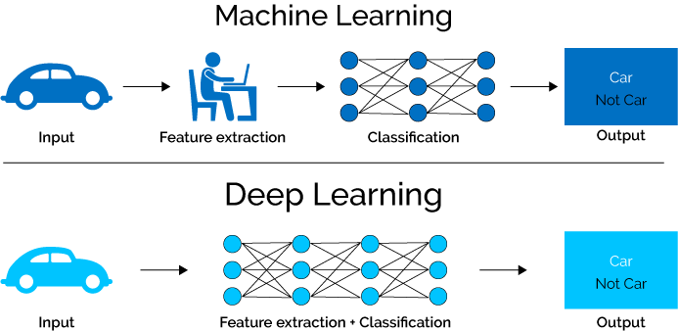

Slide 4
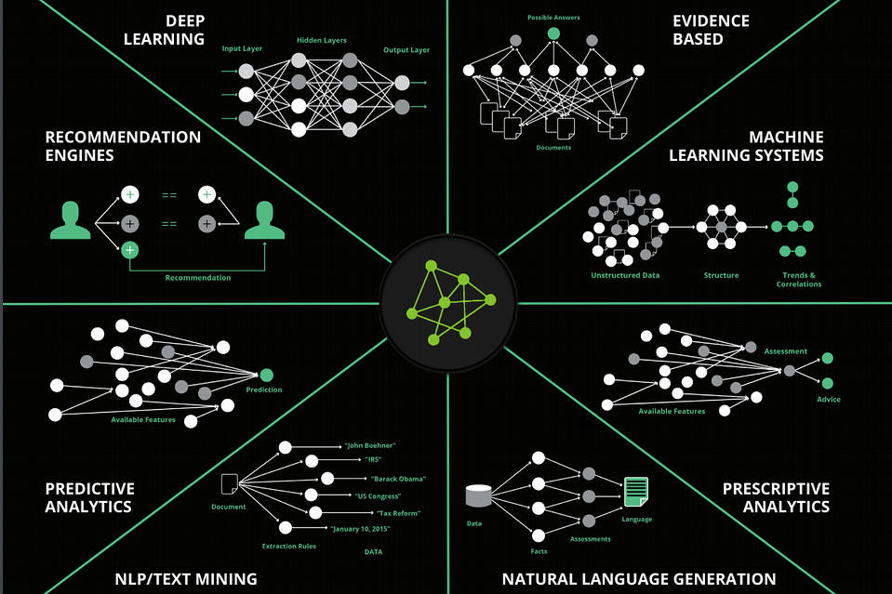

Slide 5
Types of Algorithms
Detection
Text & Sleep
Image Interpretation
Human behavior & Identity
Abuse & Fraud
Prediction
Recommendations
Individual Behavior
Collective Behavior
Generation
Visual Art
( Promo, Trailer)
Music
(Song)
Text
( Asses and Movie Review)
Design
(funny faces)

Slide 6
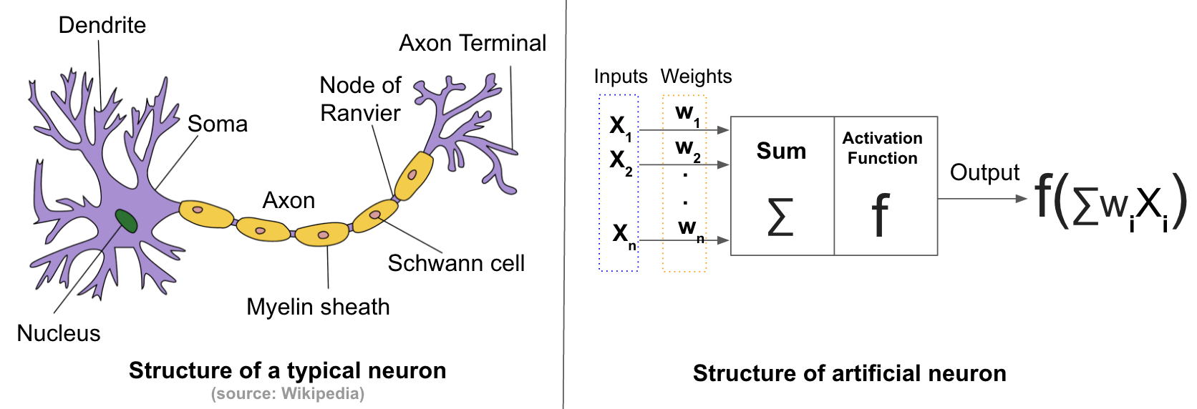
Neurons

Slide 7
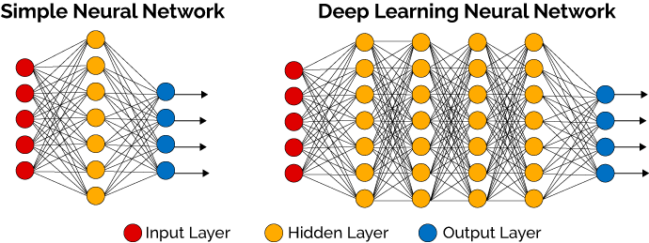
Neural Networks

Slide 8
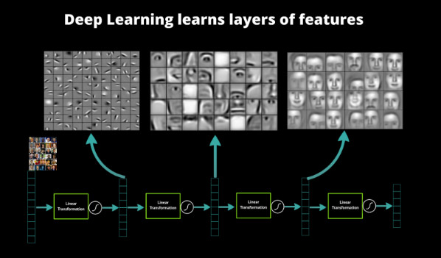

Slide 9
Learnings

Slide 10
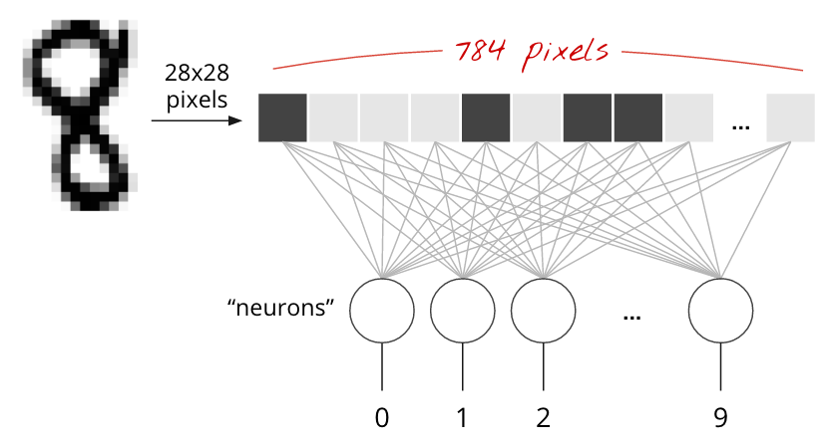
Hello world : Handwritten Digit Classification

Slide 11
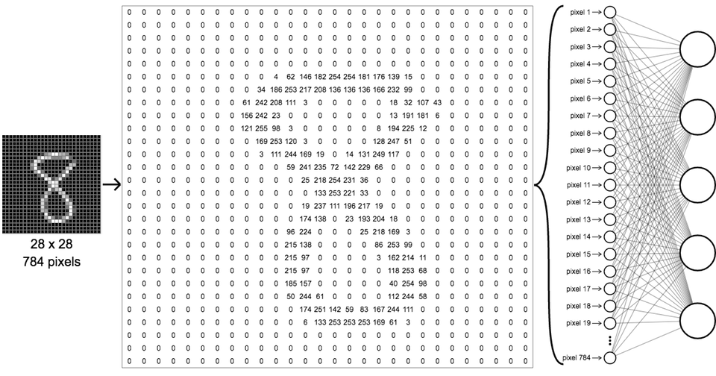

Slide 12


Slide 13
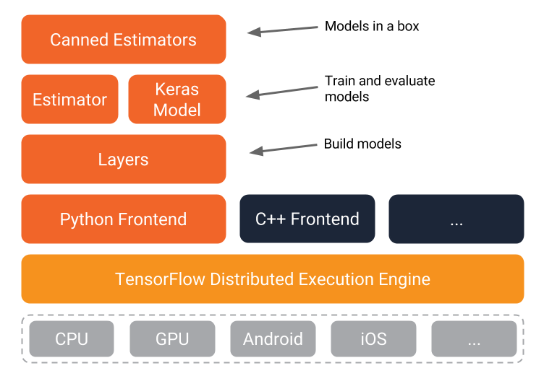
Architecture

Slide 14
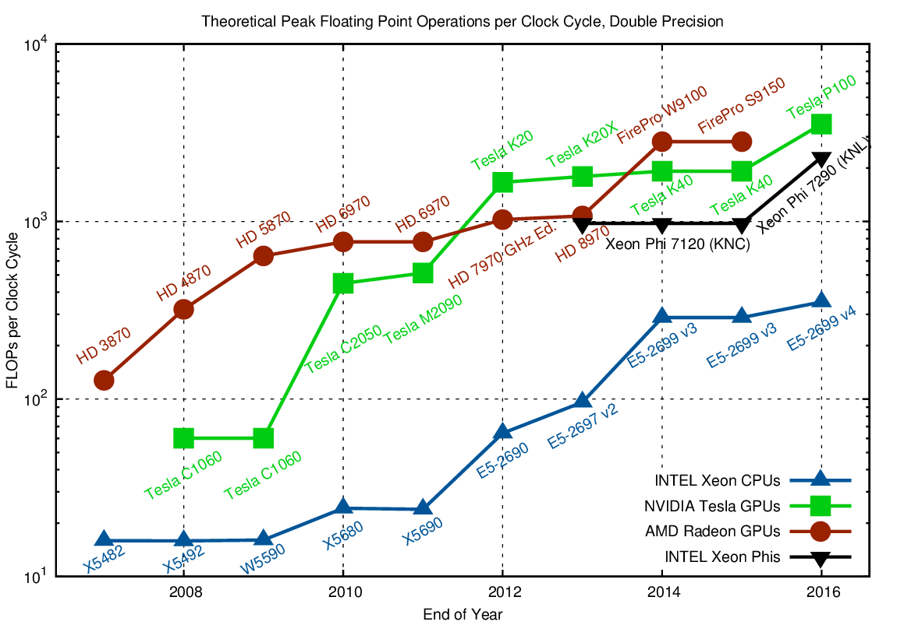
CPU vs GPU

Slide 15
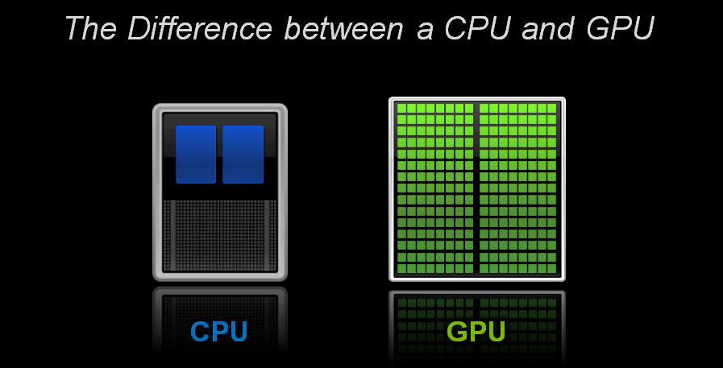

Slide 16
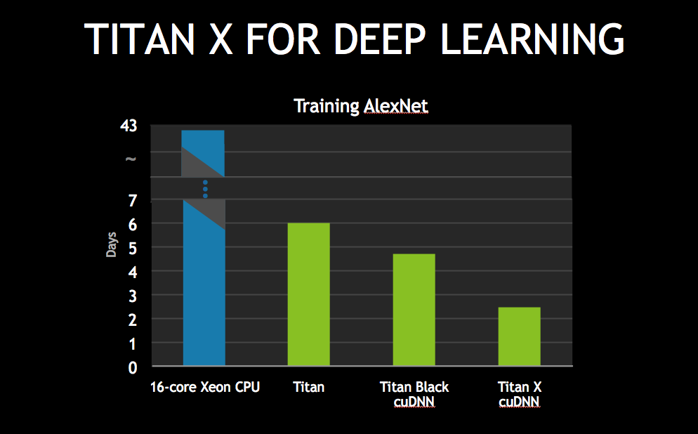
Performance

Slide 17
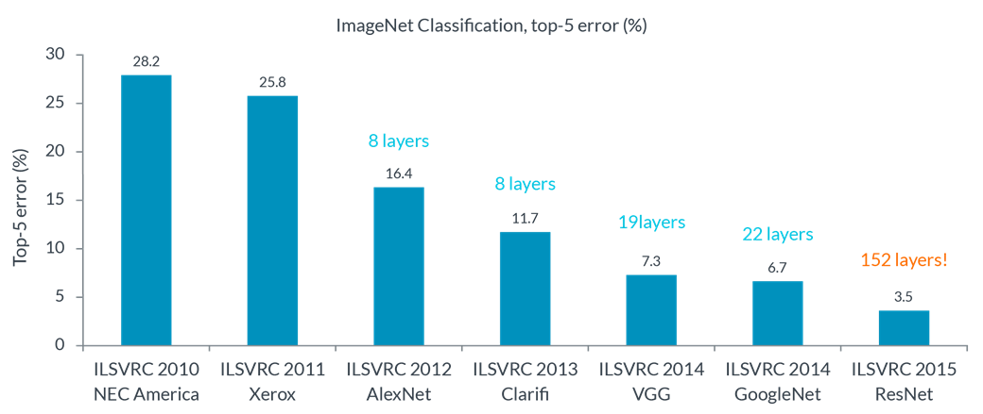

Slide 18
Demo

Slide 19
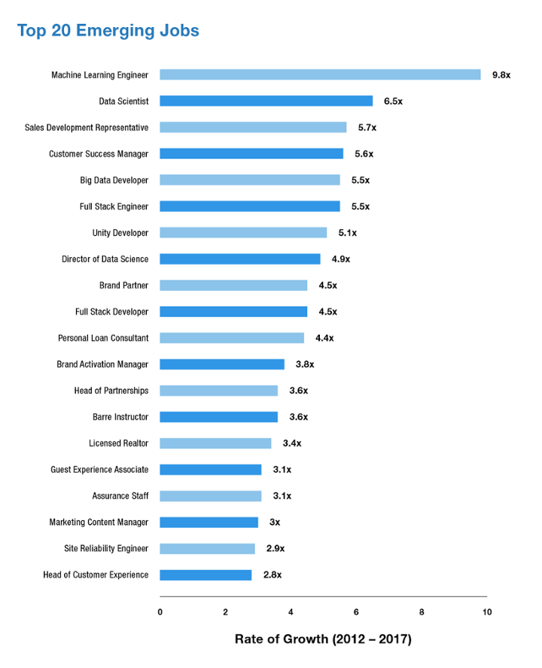

Slide 20
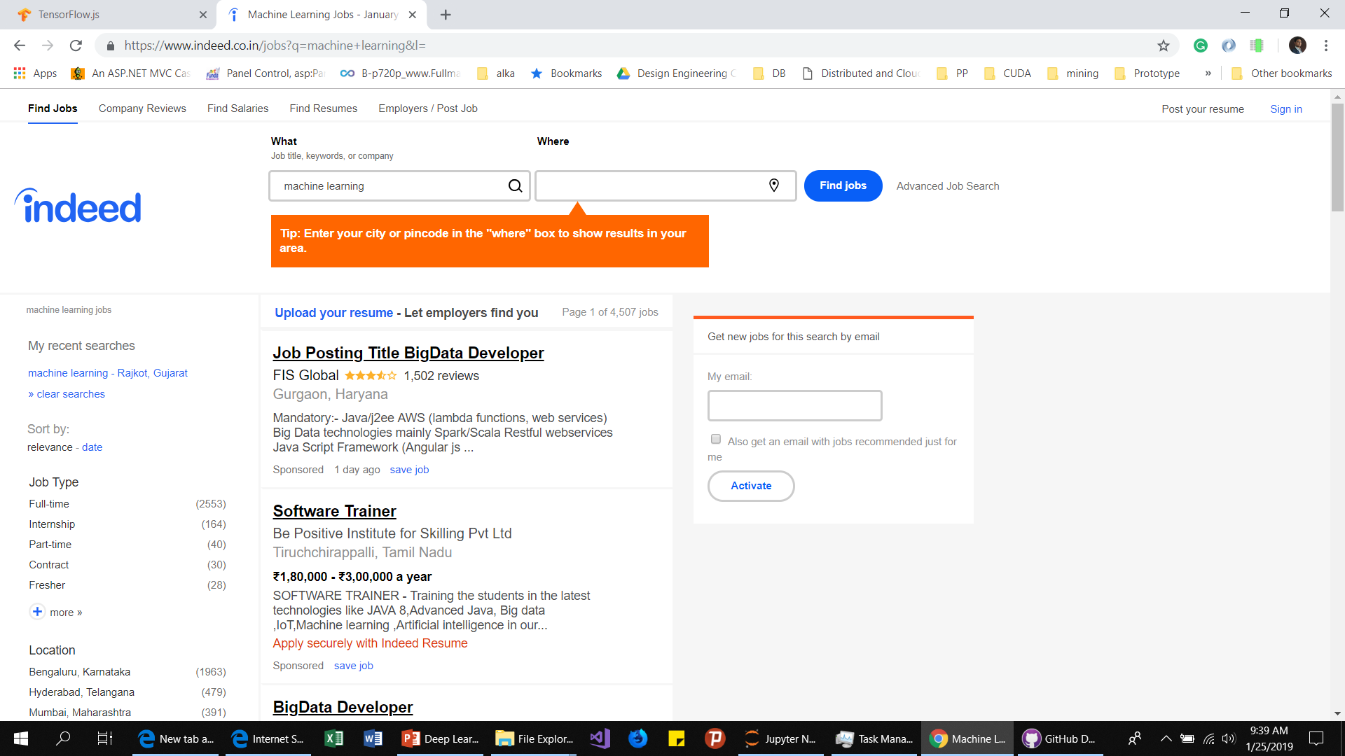

Slide 21
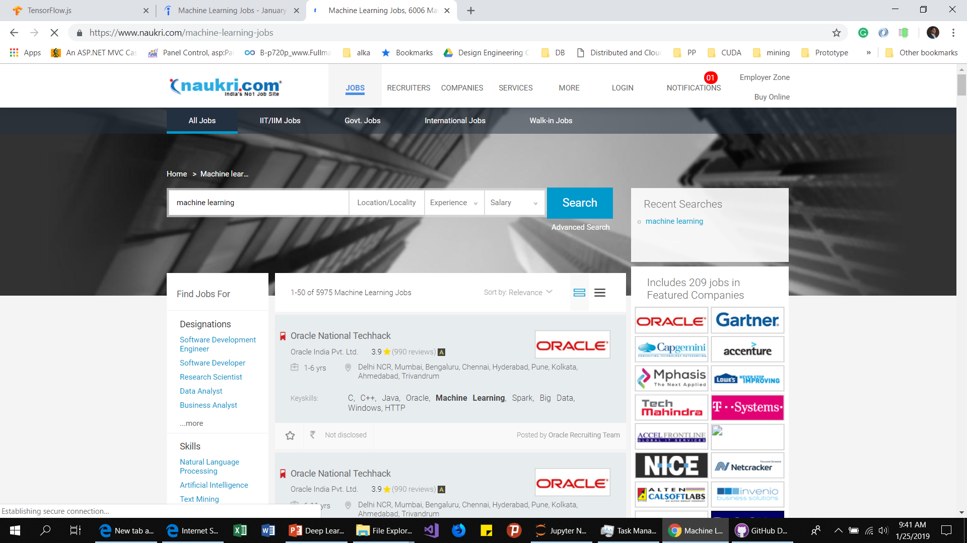

Slide 22
Useful links
https://towardsdatascience.com/
https://machinelearningmastery.com/
https://www.leadingindia.ai/
https://www.kaggle.com/

Slide 23
Session Material
https://github.com/AIAtmiyaUniversity

